Slide 1
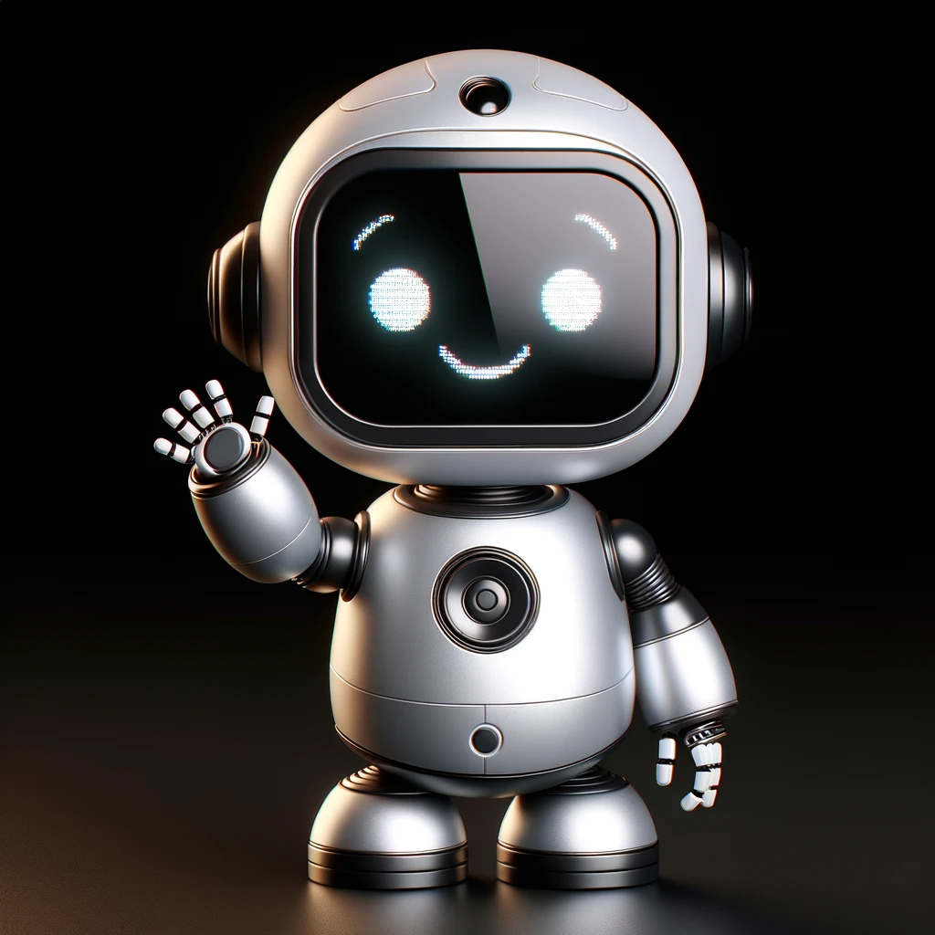
ENpm667 – Control of Robotic Systems
Project - 1
- Datta lohith G
119455395
- Charan kasturi
119444788

Slide 2
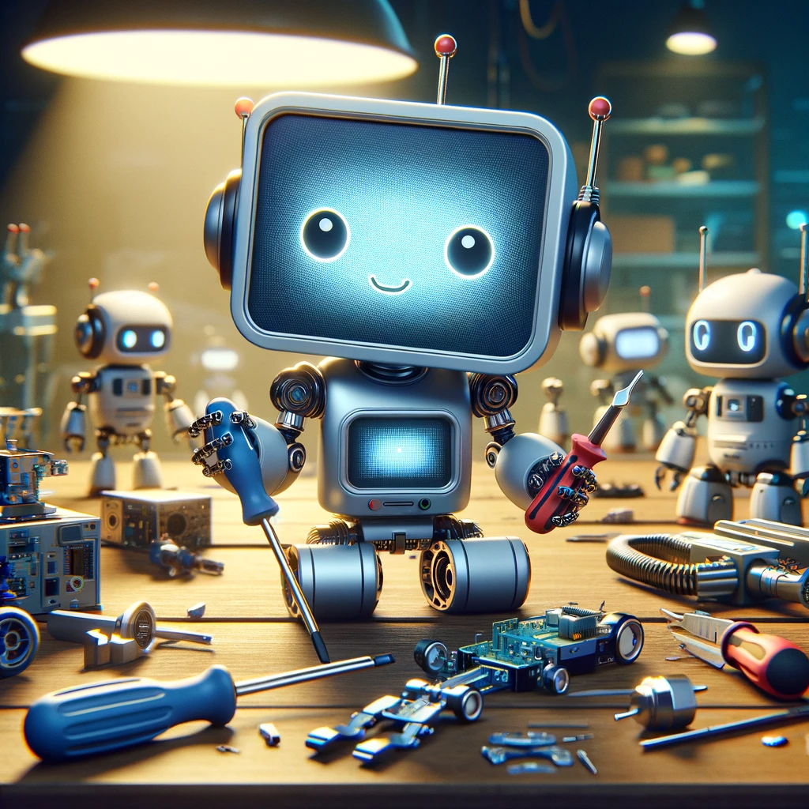
Contents
Introduction
Methodology
First-Order System Analysis
Higher order System Analysis
Simulations and Results

Slide 3
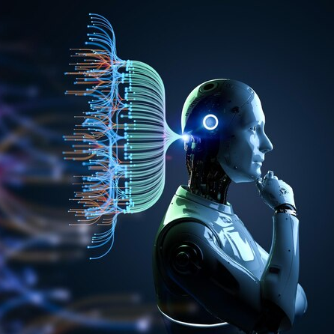
Introduction
Sliding Mode Control (SMC) is a type of control method used in control theory and applications to control the behavior of dynamic systems. Its key characteristics and principles are:
Robustness:
One of the most significant advantages of sliding mode control is its robustness against model uncertainties and external disturbances. This makes it particularly useful in systems where precise mathematical modeling is challenging or in environments with unpredictable external factors.
Chattering:
A notable phenomenon in SMC is "chattering," which is rapid oscillation of the control input and the system's state around the sliding surface. This can be undesirable in practical applications due to the potential for increased wear and tear on mechanical components. Modern SMC techniques often incorporate methods to minimize chattering.
We implement the procedure described in the paper and simulate the systems of first-order and second-order.

Slide 4

Methodology
Implementation of controllers using the implicit Euler method, suitable for suppressing numerical chattering.
Details on disturbance rejection techniques.
Mathematical models and formulations: Definition of discrete-time sliding surfaces, stability analysis, and the design of the controllers.
Disturbance rejection is achieved with a specific factor related to the sampling period, which is effective even for large sampling periods.

Slide 5
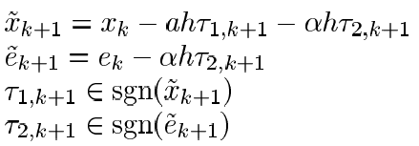
First-order Systems
We use a multivalued sign function in the paper
For a First order system with Disturbance Compensation is given by the equations
On a surface e = 0, the discrete sliding mode
system is given as

Slide 6
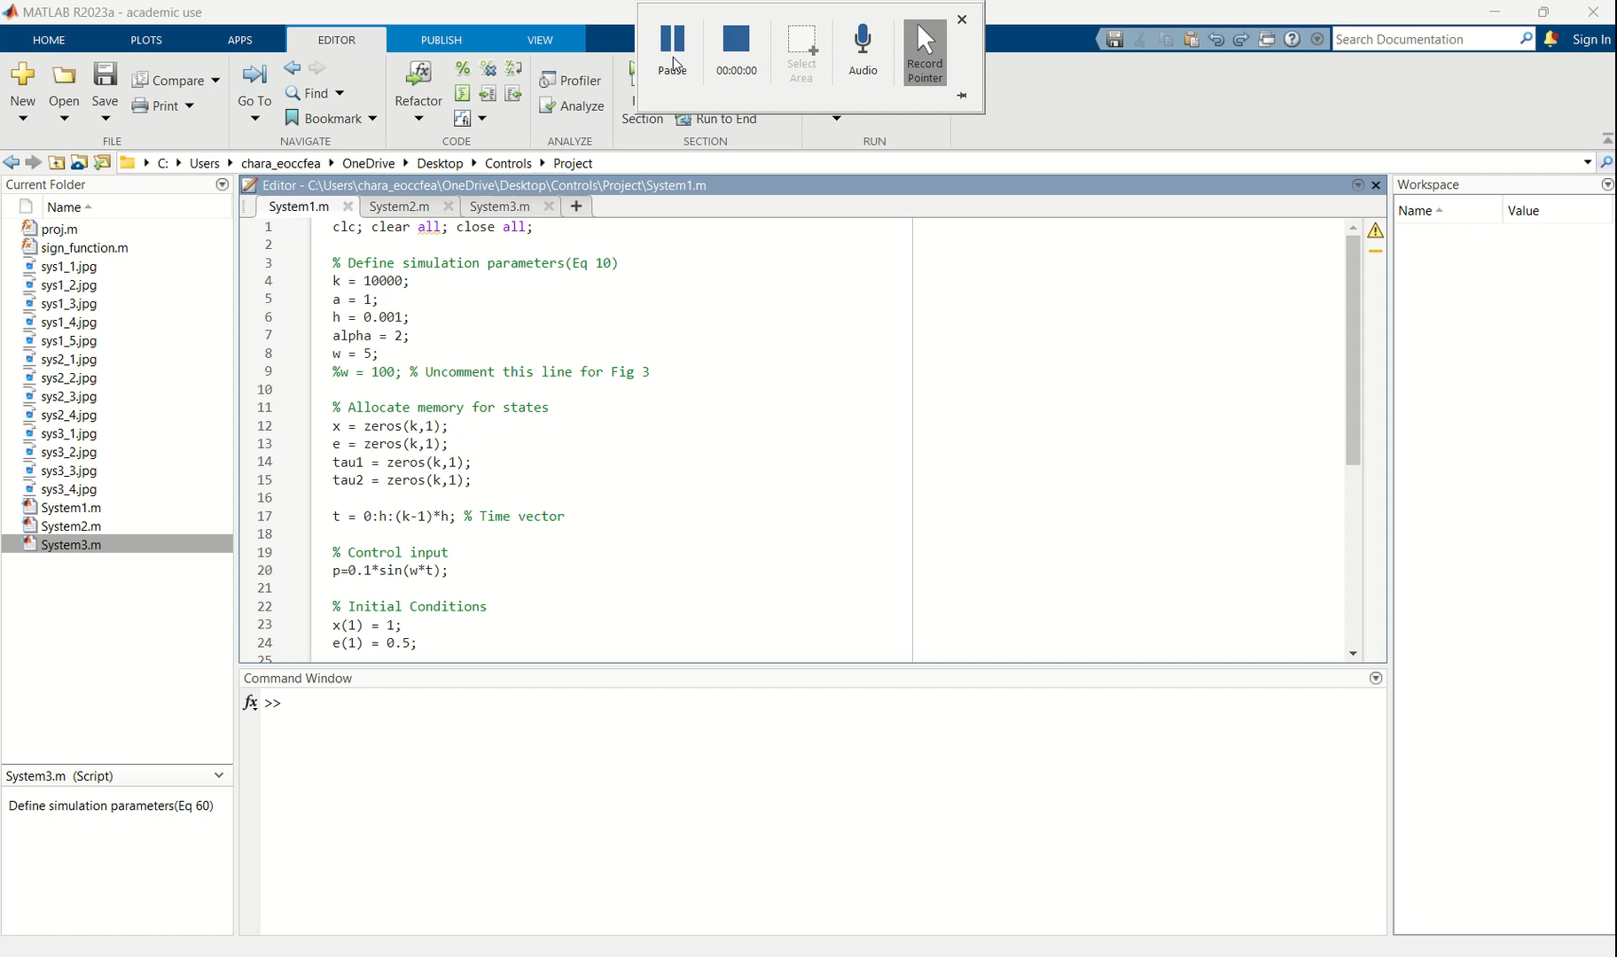
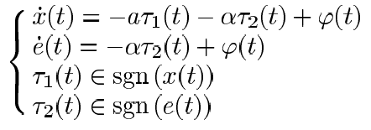
System 1
With x0,e0 being the initial conditions of the above system, the discrete-time closed loop system is given as
Simulation Result →

Slide 7
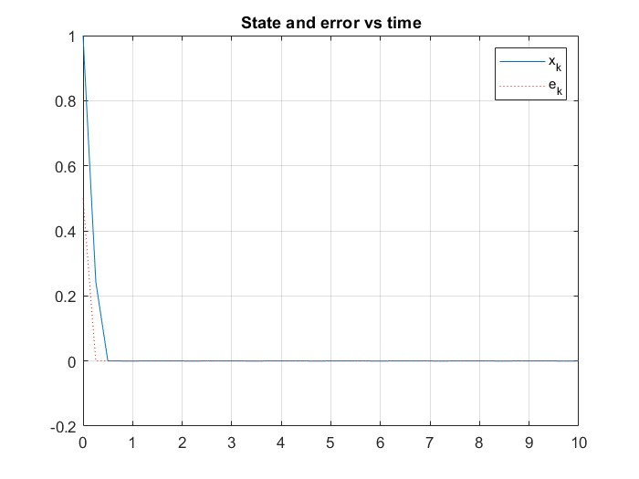
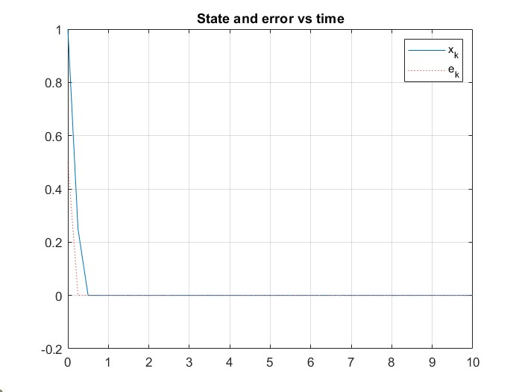
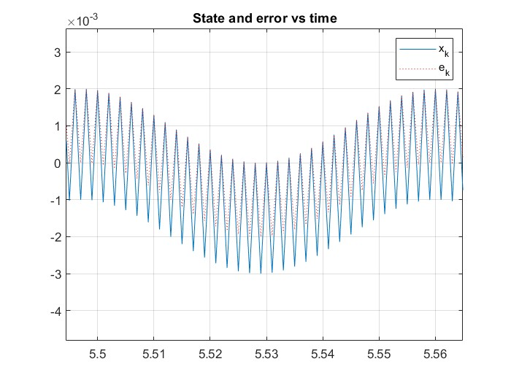
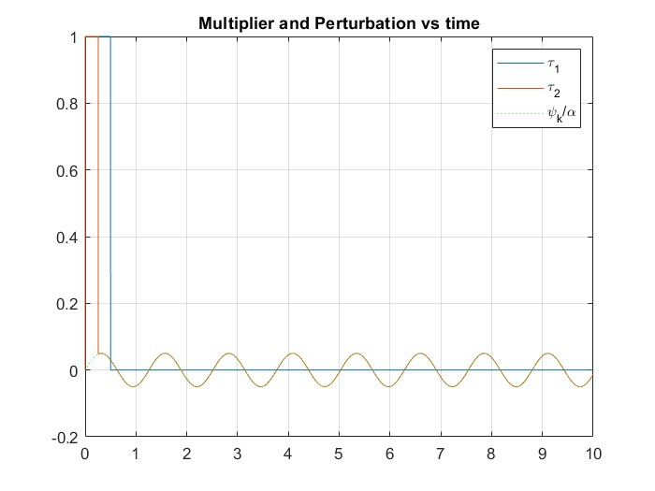
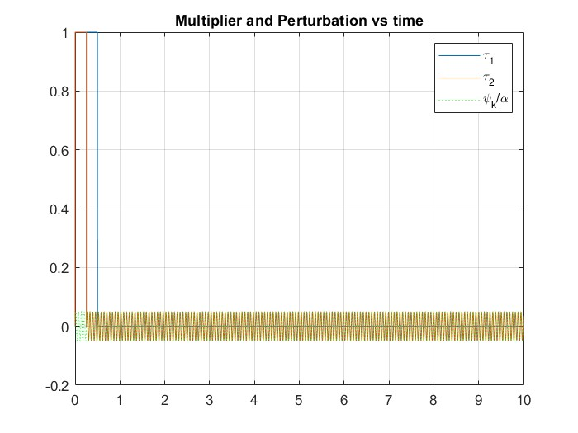
System 1

Slide 8
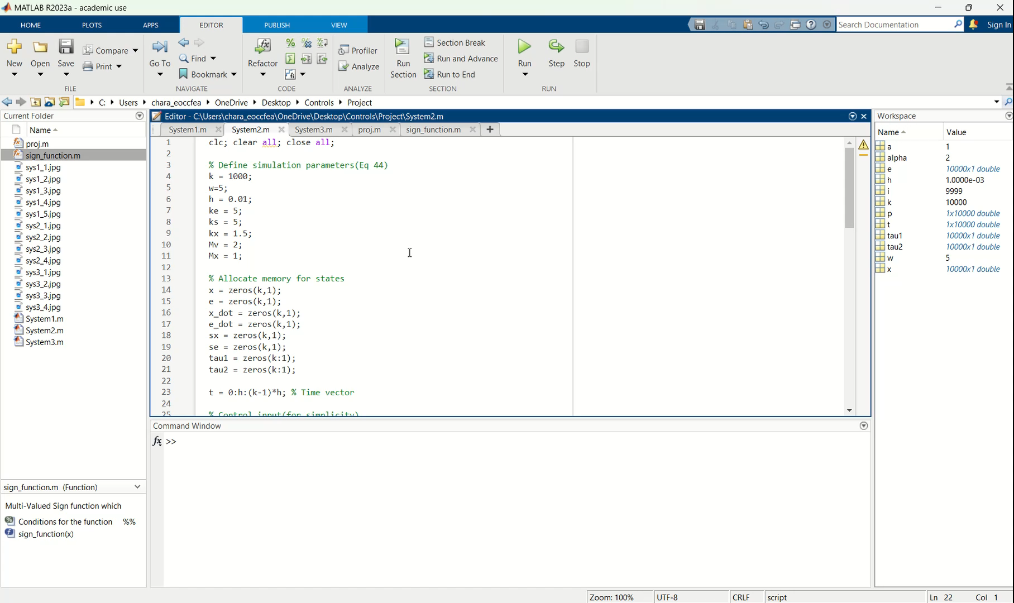
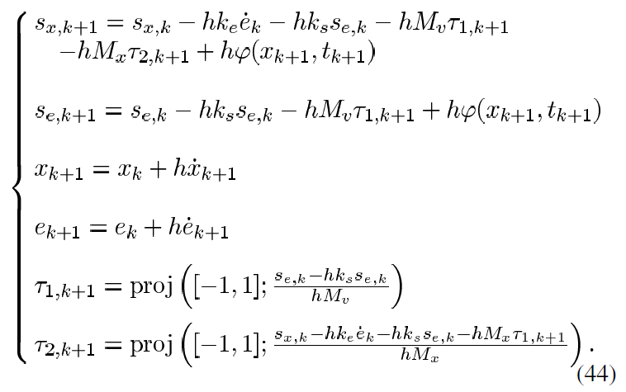
System 2
Simulation Result →

Slide 9
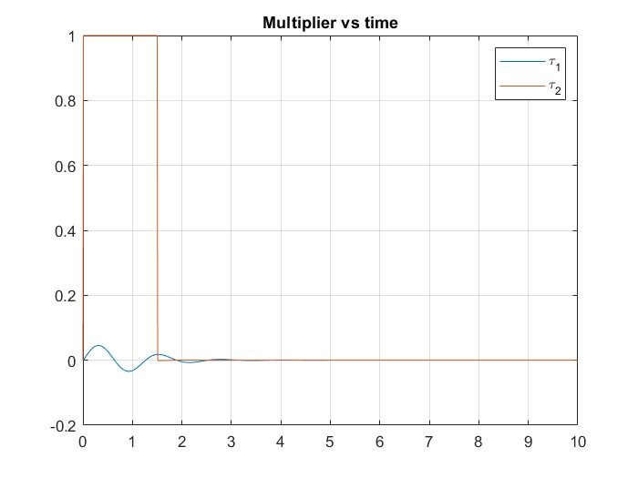
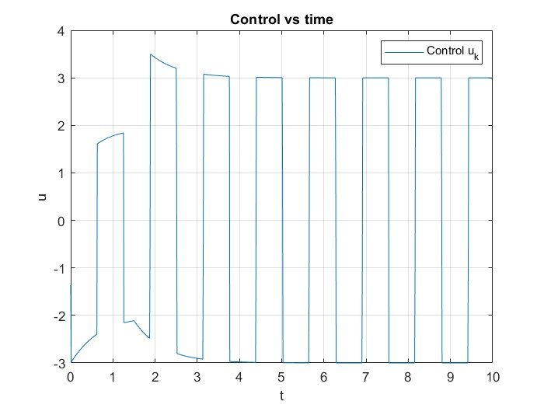
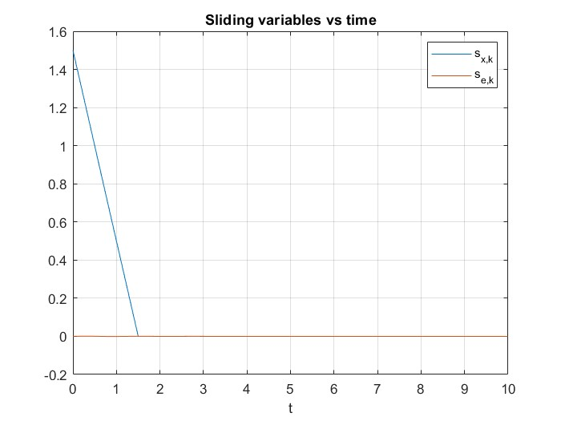
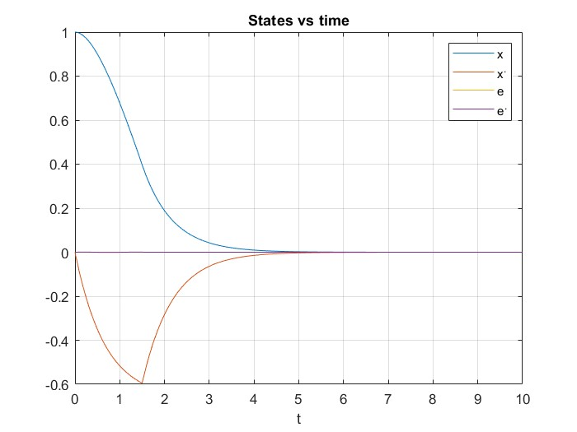
System 2

Slide 10
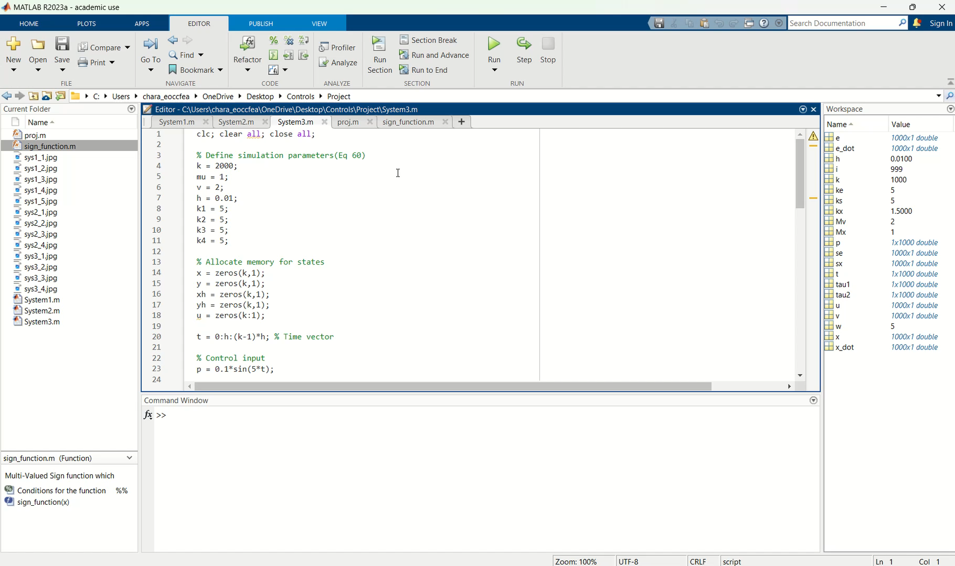
System 3
Simulation Result →

Slide 11
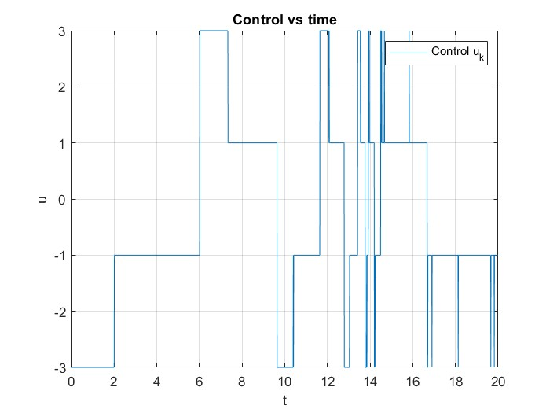
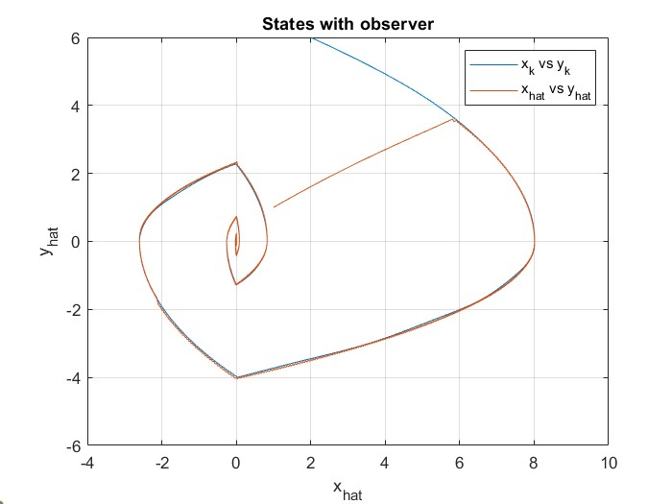
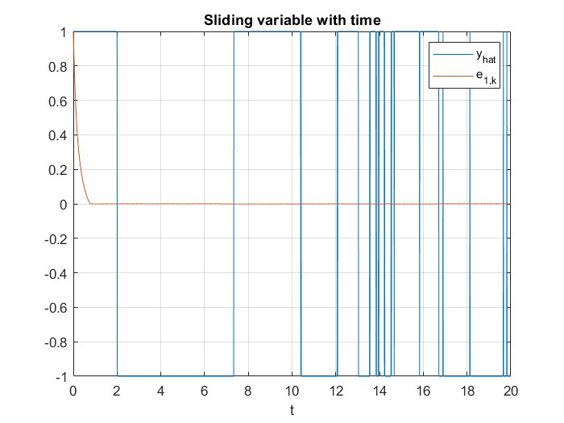
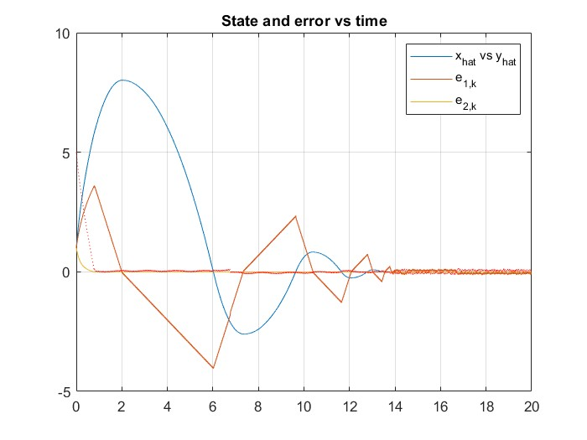
System 3

Slide 12
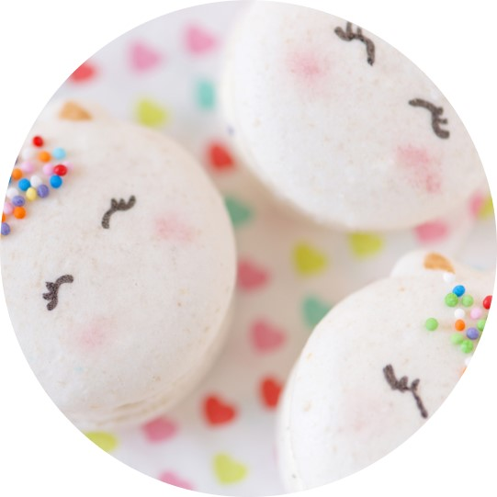


Summary
With PowerPoint, you can create presentations and share your work with others, wherever they are. Type the text you want here to get started. You can also add images, art, and videos on this template. Save to OneDrive and access your presentations from your computer, tablet, or phone.

Slide 13
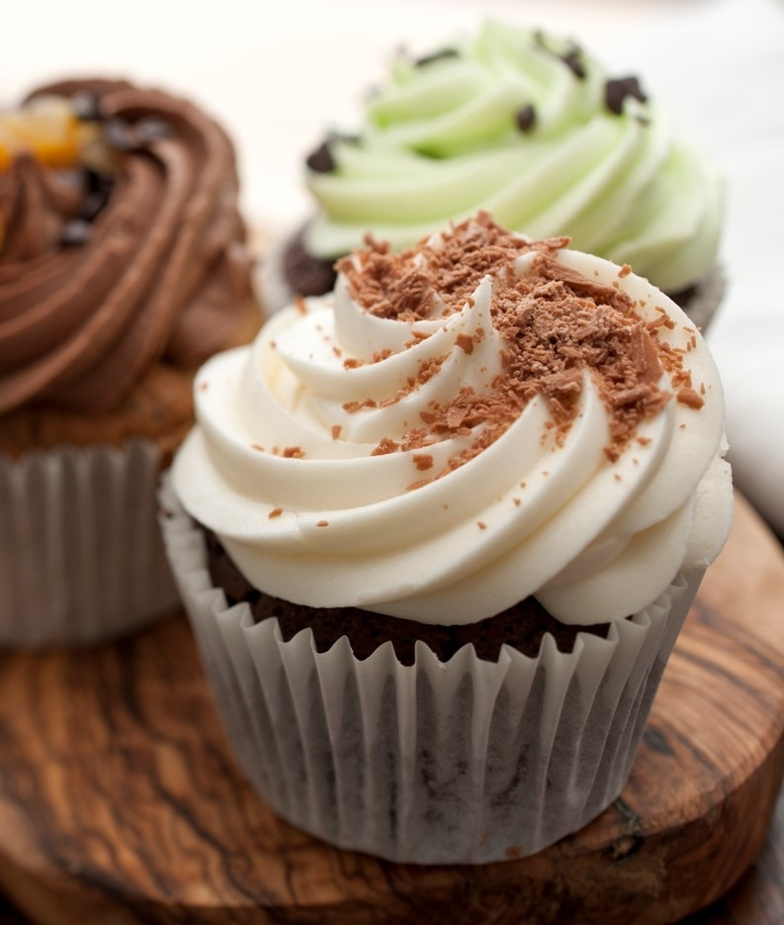
THANK YOU
PRESENTER NAME
EMAIL WEBSITE

